Slide 1
VGG 16 and VGG19

Slide 2
In 2014 there are a couple of architectures that were more significantly different and made another jump in performance, and the main difference with these networks with the deeper networks.
The VGG network architecture was introduced by Simonyan and Zisserman in their 2014 paper, Very Deep Convolutional Networks for Large Scale Image Recognition.
Reference: Simonyan, Karen, and Andrew Zisserman. "Very deep convolutional networks for large-scale image recognition." arXiv preprint arXiv:1409.1556 (2014).
VGGNet was the runner up of the ImageNet Large Scale Visual Recognition Challenge(ILSVRC) classification the benchmark in 2014.

Slide 3
What is VGG?
VGG stands for Visual Geometry Group; it is a standard deep Convolutional Neural Network (CNN) architecture with multiple layers. The “deep” refers to the number of layers with VGG-16 or VGG-19 consisting of 16 and 19 convolutional layers making it approx. — 138 trainable parameters.
The VGG architecture is the basis of ground-breaking object recognition models. Developed as a deep neural network, the VGGNet also surpasses baselines on many tasks and datasets beyond ImageNet. Moreover, it is now still one of the most popular image recognition architectures.

Slide 4
The VGG16 model achieves almost 92.7% top-5 test accuracy in ImageNet. ImageNet is a dataset consisting of more than 14 million images belonging to nearly 1000 classes.
Moreover, it was one of the most popular models submitted to ILSVRC-2014. It replaces the large kernel-sized filters with several 3×3 kernel-sized filters one after the other, thereby making significant improvements over AlexNet. The VGG16 model was trained using Nvidia Titan Black GPUs for multiple weeks.
As mentioned above, the VGGNet-16 supports 16 layers and can classify images into 1000 object categories, including keyboard, animals, pencil, mouse, etc. Additionally, the model has an image input size of 224-by-224.

Slide 5
What is VGG19?
The concept of the VGG19 model (also VGGNet-19) is the same as the VGG16 except that it supports 19 layers. The “16” and “19” stand for the number of weight layers in the model (convolutional layers). This means that VGG19 has three more convolutional layers than VGG16. We’ll discuss more on the characteristics of VGG16 and VGG19 networks in the latter part of this article.

Slide 6
VGG Architecture
The VGG network is constructed with very small convolutional filters. The VGG-16 consists of 13 convolutional layers and three fully connected layers.
Let’s take a brief look at the architecture of VGG:
Input: The VGGNet takes in an image input size of 224×224. For the ImageNet competition, the creators of the model cropped out the center 224×224 patch in each image to keep the input size of the image consistent.
Convolutional Layers: VGG’s convolutional layers leverage a minimal receptive field, i.e., 3×3, the smallest possible size that still captures up/down and left/right. Moreover, there are also 1×1 convolution filters acting as a linear transformation of the input. This is followed by a ReLU unit, which is a huge innovation from AlexNet that reduces training time. ReLU stands for rectified linear unit activation function; it is a piecewise linear function that will output the input if positive; otherwise, the output is zero. The convolution stride is fixed at 1 pixel to keep the spatial resolution preserved after convolution (stride is the number of pixel shifts over the input matrix).
Hidden Layers: All the hidden layers in the VGG network use ReLU. VGG does not usually leverage Local Response Normalization (LRN) as it increases memory consumption and training time. Moreover, it makes no improvements to overall accuracy.
Fully-Connected Layers: The VGGNet has three fully connected layers. Out of the three layers, the first two have 4096 channels each, and the third has 1000 channels, 1 for each class.

Slide 7
VGG16 Architecture
The number 16 in the name VGG refers to the fact that it is 16 layers deep neural network (VGGnet). This means that VGG16 is a pretty extensive network and has a total of around 138 million parameters. Even according to modern standards, it is a huge network. However, VGGNet16 architecture’s simplicity is what makes the network more appealing. Just by looking at its architecture, it can be said that it is quite uniform.
There are a few convolution layers followed by a pooling layer that reduces the height and the width. If we look at the number of filters that we can use, around 64 filters are available that we can double to about 128 and then to 256 filters. In the last layers, we can use 512 filters.

Slide 8
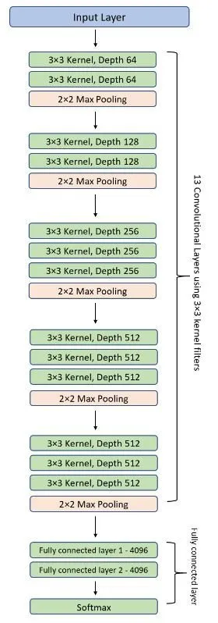

Slide 9
Complexity and challenges
The number of filters that we can use doubles on every step or through every stack of the convolution layer. This is a major principle used to design the architecture of the VGG16 network. One of the crucial downsides of the VGG16 network is that it is a huge network, which means that it takes more time to train its parameters.
Because of its depth and number of fully connected layers, the VGG16 model is more than 533MB. This makes implementing a VGG network a time-consuming task.
The VGG16 model is used in several deep learning image classification problems, but smaller network architectures such as GoogLeNet and SqueezeNet are often preferable. In any case, the VGGNet is a great building block for learning purposes as it is straightforward to implement.

Slide 10
Performance of VGG Models
VGG16 highly surpasses the previous versions of models in the ILSVRC-2012 and ILSVRC-2013 competitions. Moreover, the VGG16 result is competing for the classification task winner (GoogLeNet with 6.7% error) and considerably outperforms the ILSVRC-2013 winning submission Clarifai. It obtained 11.2% with external training data and around 11.7% without it. In terms of the single-net performance, the VGGNet-16 model achieves the best result with about 7.0% test error, thereby surpassing a single GoogLeNet by around 0.9%.

Slide 12
VGG 16 and VGG19
VGG investigate the effect of the convolutional network depth on its accuracy in the large-scale image recognition setting.
Main contribution is a thorough evaluation of networks of increasing depth using an architecture with very small (3×3) convolution filters, which shows that a significant improvement on the prior-art configurations can be achieved by pushing the depth to 16–19 weight layers.
These findings were the basis of our ImageNet Challenge 2014 submission, where researcher secured the first and the second places in the localisation and classification tracks respectively.

Slide 13
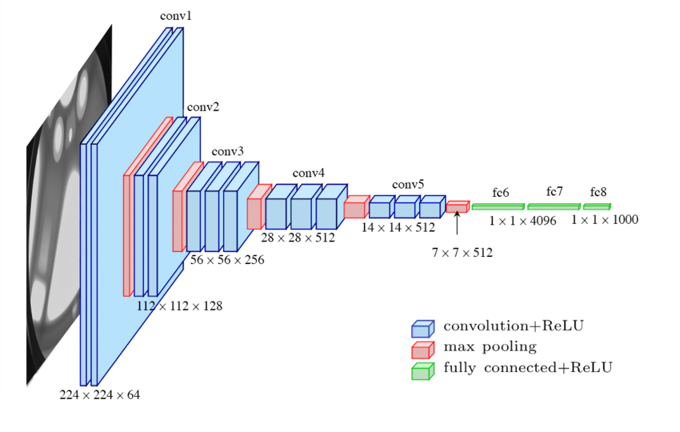
VGG 16 Architecture

Slide 14
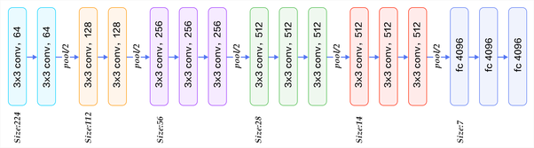
Convolution using 64 filters
Convolution using 64 filters + Max pooling
Convolution using 128 filters
Convolution using 128 filters + Max pooling
Convolution using 256 filters
Convolution using 256 filters
Convolution using 256 filters + Max pooling
Convolution using 512 filters
Convolution using 512 filters
Convolution using 512 filters + Max pooling
Convolution using 512 filters
Convolution using 512 filters
Convolution using 512 filters + Max pooling
Fully connected with 4096 nodes
Fully connected with 4096 nodes
Output layer with Softmax activation with 1000 nodes

Slide 15
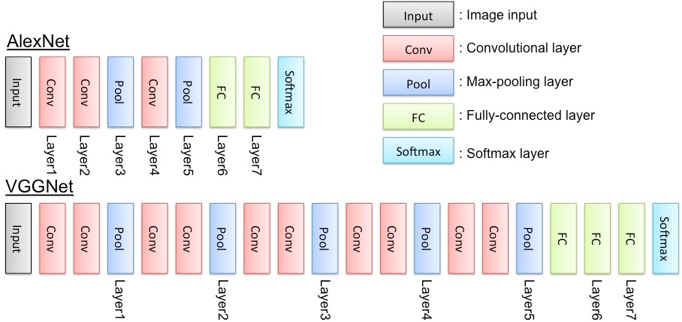

Slide 16
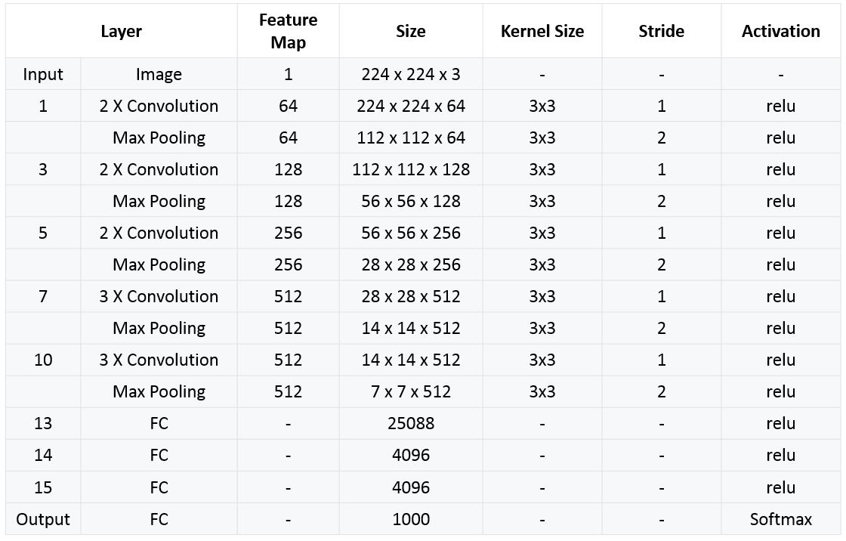

Slide 17
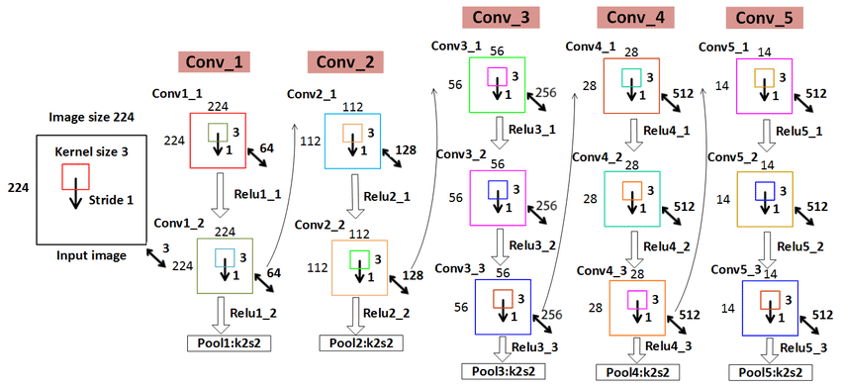

Slide 18
Input. VGG takes in a 224x224 pixel RGB image. For the ImageNet competition, the authors cropped out the center 224x224 patch in each image to keep the input image size consistent.
Convolutional Layers. The convolutional layers in VGG use a very small receptive field (3x3, the smallest possible size that still captures left/right and up/down). There are also 1x1 convolution filters which act as a linear transformation of the input, which is followed by a ReLU unit. The convolution stride is fixed to 1 pixel so that the spatial resolution is preserved after convolution.
Fully-Connected Layers. VGG has three fully-connected layers: the first two have 4096 channels each and the third has 1000 channels, 1 for each class.
Hidden Layers. All of VGG’s hidden layers use ReLU (a huge innovation from AlexNet that cut training time). VGG does not generally use Local Response Normalization (LRN), as LRN increases memory consumption and training time with no particular increase in accuracy.

Slide 19
The 16 in VGG16 refers to 16 layers that have weights. In VGG16 there are thirteen convolutional layers, five Max Pooling layers, and three Dense layers which sum up to 21 layers but it has only sixteen weight layers i.e., learnable parameters layer.
VGG16 takes input tensor size as 224, 244 with 3 RGB channel
Most unique thing about VGG16 is that instead of having a large number of hyper-parameters they focused on having convolution layers of 3x3 filter with stride 1 and always used the same padding and maxpool layer of 2x2 filter of stride 2.
The convolution and max pool layers are consistently arranged throughout the whole architecture
Conv-1 Layer has 64 number of filters, Conv-2 has 128 filters, Conv-3 has 256 filters, Conv 4 and Conv 5 has 512 filters.
Three Fully-Connected (FC) layers follow a stack of convolutional layers: the first two have 4096 channels each, the third performs 1000-way ILSVRC classification and thus contains 1000 channels (one for each class). The final layer is the soft-max layer.

Slide 20
The Difference. VGG, while based off of AlexNet, has several differences that separates it from other competing models:
Instead of using large receptive fields like AlexNet (11x11 with a stride of 4), VGG uses very small receptive fields (3x3 with a stride of 1). Because there are now three ReLU units instead of just one, the decision function is more discriminative. There are also fewer parameters (27 times the number of channels instead of AlexNet’s 49 times the number of channels).
VGG incorporates 1x1 convolutional layers to make the decision function more non-linear without changing the receptive fields.
The small-size convolution filters allows VGG to have a large number of weight layers; of course, more layers leads to improved performance. This isn’t an uncommon feature, though. GoogLeNet, another model that uses deep CNNs and small convolution filters, was also showed up in the 2014 ImageNet competition.

Slide 21
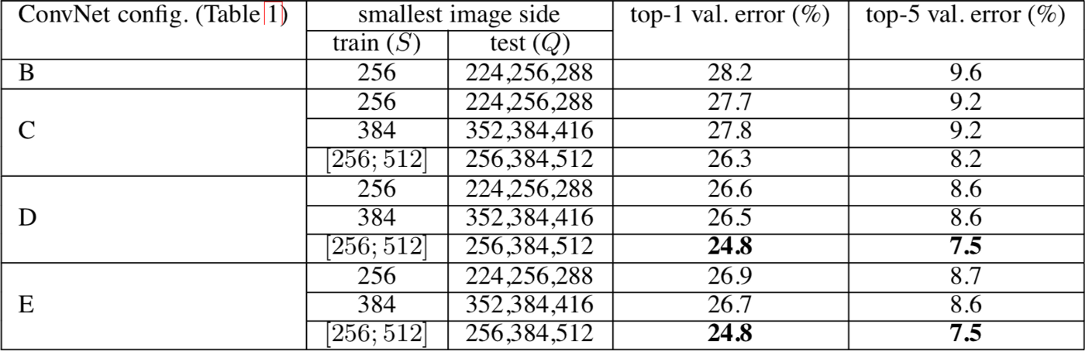

Slide 22
VGG Architecture
The input to VGG based convNet is a 224*224 RGB image. Preprocessing layer takes the RGB image with pixel values in the range of 0–255 and subtracts the mean image values which is calculated over the entire ImageNet training set.
The input images after preprocessing are passed through these weight layers. The training images are passed through a stack of convolution layers.
There are total of 13 convolutional layers and 3 fully connected layers in VGG16 architecture. VGG has smaller filters (3*3) with more depth instead of having large filters.
Another variation of VGGNet has 19 weight layers consisting of 16 convolutional layers with 3 fully connected layers and same 5 pooling layers.
In both variation of VGGNet there consists of two Fully Connected layers with 4096 channels each which is followed by another fully connected layer with 1000 channels to predict 1000 labels.
Last fully connected layer uses softmax layer for classification purpose.

Slide 23
ARCHITECTURE
During training, the input to our ConvNets is a fixed-size 224 × 224 RGB image.
The only preprocessing is subtracting the mean RGB value, computed on the training set, from each pixel.
The image is passed through a stack of convolutional (conv.) layers, where use filters with a very small receptive field: 3 × 3 (which is the smallest size to capture the notion of left/right, up/down,
The convolution stride is fixed to 1 pixel; the spatial padding of conv. layer input is such that the spatial resolution is preserved after convolution, i.e. the padding is 1 pixel for 3 × 3 conv. layers.
Spatial pooling is carried out by five max-pooling layers, which follow some of the conv. layers (not all the conv. layers are followed by max-pooling). Max-pooling is performed over a 2 × 2 pixel window, with stride 2.

Slide 24
VGG Architecture
A stack of convolutional layers (which has a different depth in different architectures) is followed by
Three Fully-Connected (FC) layers: the first two have 4096 channels each, the third performs 1000-
ILSVRC classification and thus contains 1000 channels (one for each class).
The final layer is the soft-max layer. The configuration of the fully connected layers is the same in all networks.
All hidden layers are equipped with the rectification (ReLU )non-linearity.
Networks (except for one) contain Local Response Normalisation (LRN)

Slide 25
VGG Architecture
The first two layers are convolutional layers with 3*3 filters, and first two layers use 64 filters that results in 224*224*64 volume as same convolutions are used. The filters are always 3*3 with stride of 1
After this, pooling layer was used with max-pool of 2*2 size and stride 2 which reduces height and width of a volume from 224*224*64 to 112*112*64.
This is followed by 2 more convolution layers with 128 filters. This results in the new dimension of 112*112*128.
After pooling layer is used, volume is reduced to 56*56*128.
Two more convolution layers are added with 256 filters each followed by down sampling layer that reduces the size to 28*28*256.
Two more stack each with 3 convolution layer is separated by a max-pool layer.
After the final pooling layer, 7*7*512 volume is flattened into Fully Connected (FC) layer with 4096 channels and softmax output of 1000 classes.

Slide 26
Summary of VGGNet improvement points
A smaller 3 3 convolution kernel and a deeper network are used . The stack of two 3 3 convolution kernels is relative to the field of view of a 5 5 convolution kernel, and the stack of three 3 3 convolution kernels is equivalent to the field of view of a 7 7 convolution kernel. In this way, there can be fewer parameters (3 stacked 3 3 structures have only 7 7 structural parameters (3 3 3) / (7 7) = 55%); on the other hand, they have more The non-linear transformation increases the ability of CNN to learn features.
In the convolutional structure of VGGNet, a 1 * 1 convolution kernel is introduced. Without affecting the input and output dimensions, non-linear transformation is introduced to increase the expressive power of the network and reduce the amount of calculation.
During training, first train a simple (low-level) VGGNet A-level network, and then use the weights of the A network to initialize the complex models that follow to speed up the convergence of training .

Slide 27
VGG Training
The optimization method is a stochastic gradient descent SGD + momentum (0.9) with momentum. The batch size is 256.
Regularization : L2 regularization is used, and the weight decay is 5e-4. Dropout is after the first two fully connected layers, p = 0.5.
Although it is deeper and has more parameters than the AlexNet network, we speculate that VGGNet can converge in less cycles for two reasons: one, the greater depth and smaller convolutions bring implicit regularization ; Second, some layers of pre-training.
Parameter initialization : For a shallow A network, parameters are randomly initialized, the weight w is sampled from N (0, 0.01), and the bias is initialized to 0. Then, for deeper networks, first the first four convolutional layers and three fully connected layers are initialized with the parameters of the A network. However, it was later discovered that it is also possible to directly initialize it without using pre-trained parameters.
In order to obtain a 224 * 224 input image, each rescaled image is randomly cropped in each SGD iteration. In order to enhance the data set, the cropped image is also randomly flipped horizontally and RGB color shifted.

Slide 28
TRAINING
Namely, the training is carried out by optimising the multinomial logistic regression objective using mini-batch gradient descent based on back-propagation with momentum.
The batch size was set to 256, momentum to 0.9. The training was regularised by weight decay (the L2 penalty multiplier set to and dropout regularisation for the first two fully-connected layers (dropout ratio set to 0.5).
The learning rate was initially set to 10−2, and then decreased by a factor of 10 when the validation set accuracy stopped improving.
In total, the learning rate was decreased 3 times, and the learning was stopped after 370K iterations (74 epochs).

Slide 29
Tranning
The initialization of the network weights is important, since bad initialization can stall learning due to the instability of gradient in deep nets.
To circumvent this problem, shallow enough to be trained with random initialisation. Then, when training deeper architectures, we initialised the first four convolutional layers and the last three fullyconnected layers with the layers of net A (the intermediate layers were initialised randomly).
Here did not decrease the learning rate for the pre-initialised layers, allowing them to change during learning.
For random initialization (where applicable), sampled the weights from a normal distribution with the zero mean and 10−2 variance.
The biases were initialized with zero.
To obtain the fixed-size 224×224 ConvNet input images, they were randomly cropped from rescaled training images (one crop per image per SGD iteration).

Slide 30
IMPLEMENTATION DETAILS
Implementation is derived from the publicly available C++ Caffe toolbox
Training and evaluation on multiple GPUs installed in a single system, as well as train and evaluate on
full-size (uncropped) images at multiple scales (as described above).
Multi-GPU training exploits data parallelism, and is carried out by splitting each batch of training images into several GPU batches, processed in parallel on each GPU. After the GPU batch gradients are computed, they are averaged to obtain the gradient of the full batch.
Gradient computation is synchronous across the GPUs, so the result is exactly the same as when training on a single GPU. While more sophisticated methods of speeding up ConvNet training have been recently proposed
On a system equipped with four NVIDIA Titan Black GPUs, training a single net took 2–3 weeks depending on the architecture.

Slide 31
Architecture comparison of AlexNet, VGGNet
VGG network is the idea of much deeper networks and with much smaller filters.
VGGNet increased the number of layers from eight layers in AlexNet. Right now it had models with 16 to 19 layers variant of VGGNet.
One key thing is that these models kept very small filters with 3 x 3 conv all the way, which is basically the smallest conv filter size that is looking at a little bit of the neighbouring pixels.
And they just kept this very simple structure of 3 x 3 convs with the periodic pooling all the way through the network.

Slide 32
Architecture comparison of AlexNet, VGGNet
VGG used small filters because of fewer parameters and stack more of them instead of having larger filters.
VGG has smaller filters with more depth instead of having large filters.
It has ended up having the same effective receptive field as if you only have one 7 x 7 convolutional layers.
VGGNet has conv layers and a pooling layer a couple more conv layers, pooling layer, several more conv layers and so on.
VGG architecture has the 16 total number of convolutional and fully connected layers.
It has 16 in this case for VGG 16, and then 19 for VGG 19, it’s just a very similar architecture, but with a few more conv layers in there.

Slide 33
What does the terms Top-1 and Top-5 val error mean ?
These are terms used to describe the accuracy of an algorithm on a classification task.
Let’s say that there are 100 classes, and the classifier has to guess which class an input belongs to.
The classifier outputs a score or confidence value for each class (“I’m 90% sure this image is of a dog”, “I’m 0.1% sure that this image is of a plane”, etc.).
If the classifier’s top guess is the correct answer (e.g., the highest score is for the “dog” class, and the test image is actually of a dog), then the correct answer is said to be in the Top-1.
If the correct answer is at least among the classifier’s top 5 guesses, it is said to be in the Top-5.

Slide 34
Results
On a single test scale, VGG achieved a top-1 error of 25.5% and a top-5 error of 8.0%. At multiple test scales, VGG got a top-1 error of 24.8% and a top-5 error of 7.5%. VGG also achieved second place in the 2014 ImageNet competition with its top-5 error of 7.3%, which they decreased to 6.8% after the submission.

Slide 35
Two major drawbacks with VGGNet:
1. It is painfully slow to train.
2.The network architecture weights themselves are quite large (in terms of disk/bandwidth).
Due to its depth and number of fully-connected nodes, VGG is over 533MB for VGG16 and 574MB for VGG19. This makes deploying VGG a tiresome task.
Use VGG in many deep learning image classification problems; however, smaller network architectures are often more desirable (such as SqueezeNet, GoogLeNet, etc.).
The size of VGG-16 trained imageNet weights is 528 MB. So, it takes quite a lot of disk space and bandwidth which makes it inefficient.
138 million parameters lead to exploding gradients problem.
Further advancements: Resnets are introduced to prevent exploding gradients problem that occurred in VGG-16.

Slide 36
VGGNet vs. ResNet
However, as the gradient keeps flowing backward to the initial layers, the value keeps increasing by each local gradient. This results in the gradient becoming smaller and smaller, thereby making changes to the initial layers very small. This, in turn, increases the training time significantly.
The problem can be solved if the local gradient becomes 1. This is where ResNet comes into the picture since it achieves this through the identity function. So, as the gradient is back-propagated, it does not decrease in value because the local gradient is 1.
Deep residual networks (ResNets), such as the popular ResNet-50 model, are another type of convolutional neural network architecture (CNN) that is 50 layers deep. A residual neural network uses the insertion of shortcut connections in turning a plain network into its residual network counterpart. Compared to VGGNets, ResNets are less complex since they have fewer filters.
ResNet, also referred to as Residual Network, does not allow the vanishing gradient problem to occur. The skip connections act as gradient superhighways, which allow the gradient to flow undisturbed. This is also one of the most important reasons why ResNet comes in versions like ResNet50, ResNet101, and ResNet152.

Slide 37
VGGNet vs. ResNet
VGG stands for Visual Geometry Group and consists of blocks, where each block is composed of 2D Convolution and Max Pooling layers. It comes in two models — VGG16 and VGG19 — with 16 and 19 layers.
As the number of layers increases in CNN, the ability of the model to fit more complex functions also increases. Hence, more layers promise better performance. This should not be confused with an Artificial Neural Network (ANN), where an increase in the number of layers doesn’t necessarily result in a better performance.
Now the question is, why shouldn’t you use a VGGNet with more layers, such as VGG20, or VGG50, or VGG100? This is where the problem arises. The weights of a neural network are updated through the backpropagation algorithm, which makes a minor change to each weight so that the loss of the model decreases.
But how does it occur? It updates each weight so that it takes a step in the direction along which the loss decreases. This is nothing but the gradient of this weight which can be found using the chain rule.
However, as the gradient keeps flowing backward to the initial layers, the value keeps increasing by each local gradient. This results in the gradient becoming smaller and smaller, thereby making changes to the initial layers very small. This, in turn, increases the training time significantly.
The problem can be solved if the local gradient becomes 1. This is where ResNet comes into the picture since it achieves this through the identity function. So, as the gradient is back-propagated, it does not decrease in value because the local gradient is 1.
Deep residual networks (ResNets), such as the popular ResNet-50 model, are another type of convolutional neural network architecture (CNN) that is 50 layers deep. A residual neural network uses the insertion of shortcut connections in turning a plain network into its residual network counterpart. Compared to VGGNets, ResNets are less complex since they have fewer filters.
ResNet, also referred to as Residual Network, does not allow the vanishing gradient problem to occur. The skip connections act as gradient superhighways, which allow the gradient to flow undisturbed. This is also one of the most important reasons why ResNet comes in versions like ResNet50, ResNet101, and ResNet152.

Slide 38
Q1: Why can 3 3x3 convolutions replace 7x7 convolutions?
Answer 1 3 3x3 convolutions, using 3 non-linear activation functions, increasing non-linear expression capabilities, making the segmentation plane more separable Reduce the number of parameters. For the convolution kernel of C channels, 7x7 contains parameters , and the number of 3 3x3 parameters is greatly reduced.
Q2: The role of 1x1 convolution kernel
Answer 2 Increase the nonlinearity of the model without affecting the receptive field 1x1 winding machine is equivalent to linear transformation, and the non-linear activation function plays a non-linear role
Q3: The effect of network depth on results (in the same year, Google also independently released the network GoogleNet with a depth of 22 layers)
Answer 3 VGG and GoogleNet models are deep Small convolution VGG only uses 3x3, while GoogleNet uses 1x1, 3x3, 5x5, the model is more complicated (the model began to use a large convolution kernel to reduce the calculation of the subsequent machine layer)

Slide 39
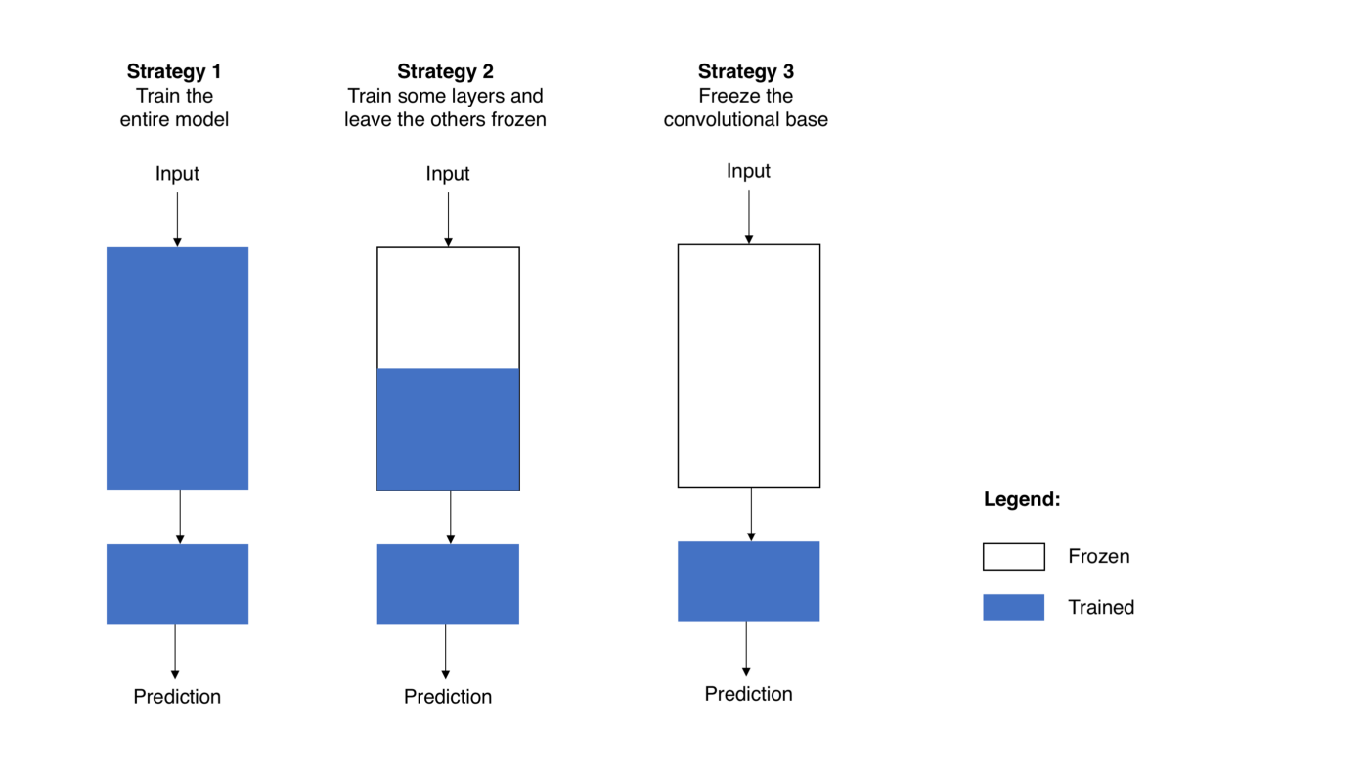
Fine-tuning strategies

Slide 40
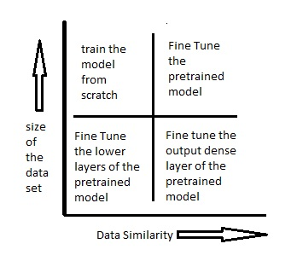
Ways to Fine tune the model

Slide 41
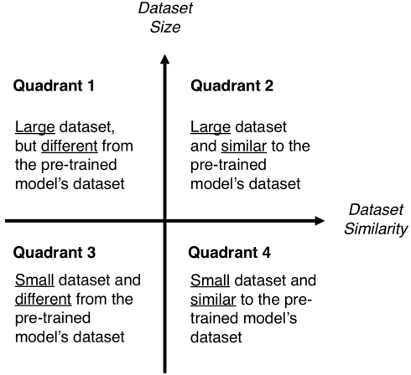
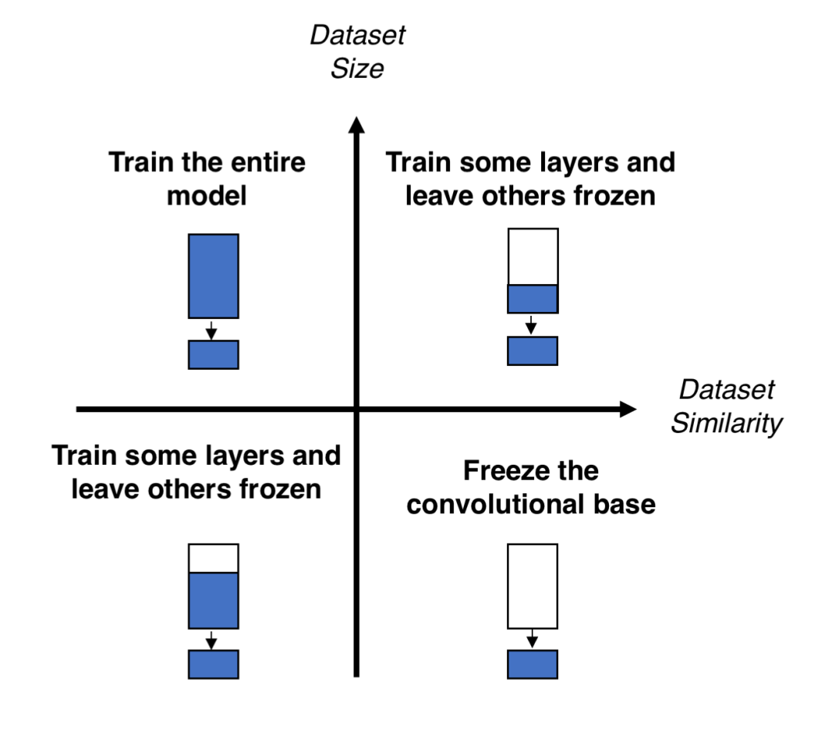
Size-Similarity matrix (left) and decision map for fine-tuning pre-trained models (right).

